Slide 1



An ACCS Alumni Study
Notes:
In Luke 8, we see an example of well cultivated soil ready to receive the Word of God. Classical Christian education has cultivated each generation in every century since Christ came, until the turn of the 20th century. Over the past 30 years, our ACCS member schools have restarted this tradition to help cultivate a new generation of believers.

Slide 2

“Education is teaching our children to desire the right things.”
Plato
Notes:
So, we’re often asked if this approach works or not. To find out, we’ve tracked the academic success of our students for many years. Our alumni perform favorably against every group measured. But how are their lives affected by their time in a classical Christian school? We wanted to find out in a more comprehensive way than test scores.

Slide 3

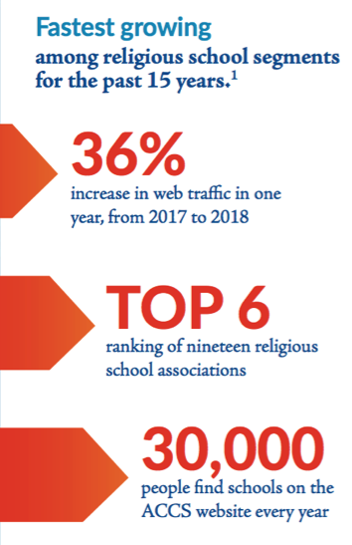
We represent around 300 member schools, about 50 of which are accredited with about 50,000 students
We hold members, particularly Accredited Members, to standards of consistency and classical methodology. Most respondents were from Accredited ACCS Schools.
Our schools were started mostly between 1993 and 2010.
Notes:
First, a bit about the ACCS. For those who might not be familiar with the ACCS, we were founded in 1994 as the classical Christian movement began. Over the past 25+ years, we’ve grown to be among the top six Christian school associations by number of schools, and we have seen significant growth in the interest in classical Christian education in recent years. Each year, over 30,000 people use our school finder on the web to find a local classical Christian school.
We presently have about 300 members representing about 50,000 students. Our membership and accreditation standards tend to be more specific in the area of content and method because we seek members that represent classical Christian education well. This results in schools that, we hope, practice classical Christian education with attention to continuous improvement.

Slide 4
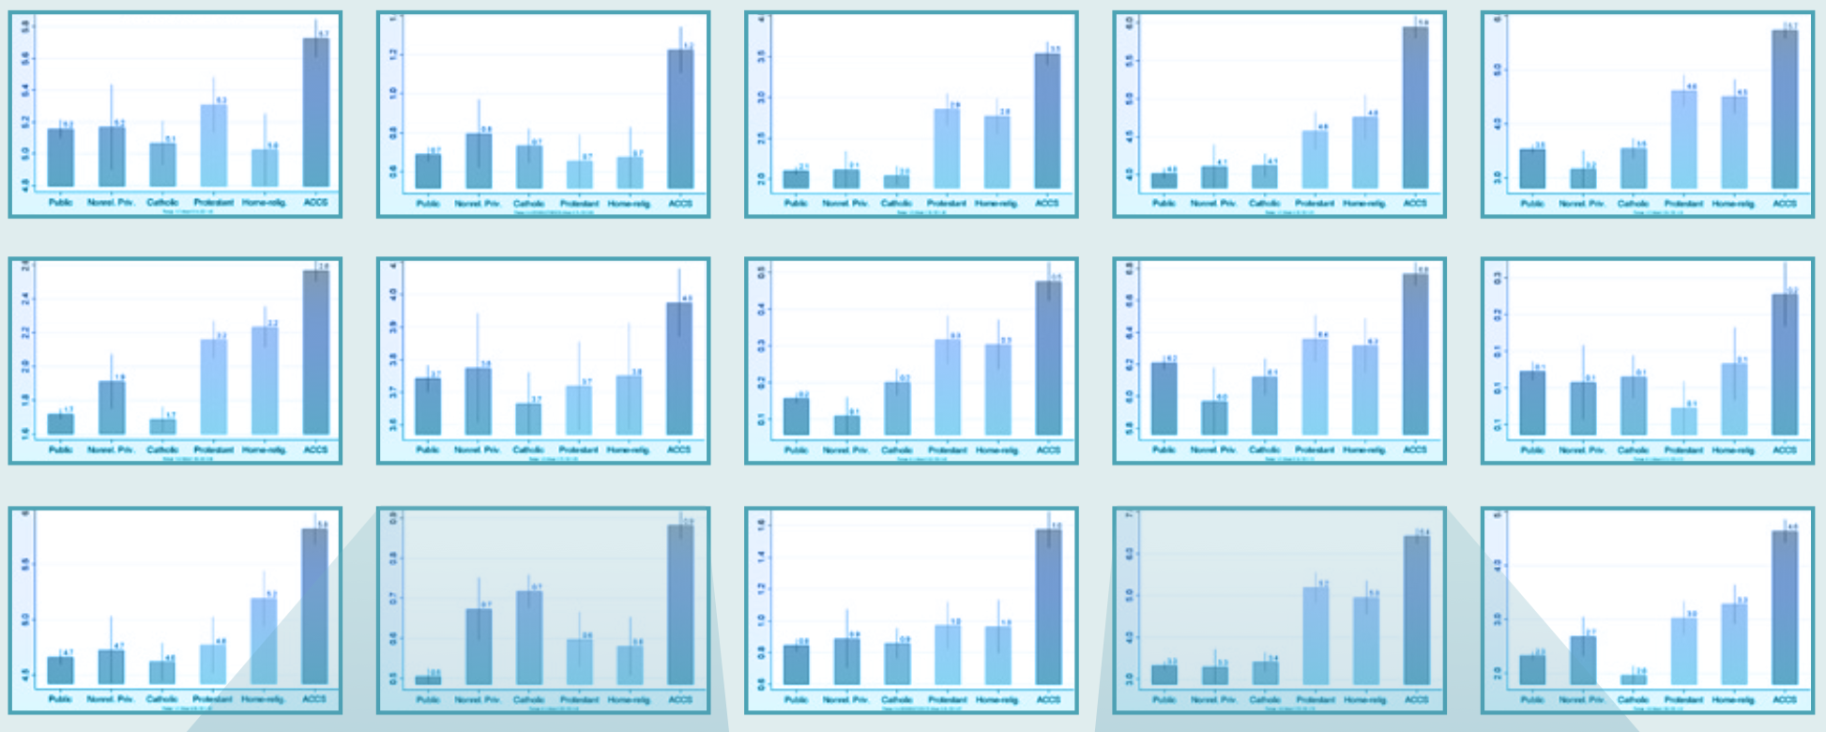

The Survey showed a very distinctive pool of alumni
Notes:
With over 300 slides across the survey, the differences were pronounced. Here, we have taken a sample of the slides to show the magnitude of the differences at a glance. The dark blue bar on the right represents the ACCS respondents. In a survey of this type, the greatness of the differences shown indicates that something is unique about ACCS graduates. In about 1/3 of the data, the distinctions between the groups were not this pronounced.

Slide 5

Survey details
The Survey was independently developed by Cardus and the University Notre Dame. The ACCS had no input on the questions or their form. The survey was over 80 pages (when printed).
Tracking survey conducted in 2011 and 2014 and 2018 for Cardus. ACCS had the University of Notre Dame independently surveyed our alumni in 2018 using the same methodology so that our data could be compared to the 5 groups surveyed by Cardus.
To ensure appropriate sampling, the ACCS provided 3000 alumni names from which 300 were selected—the same or more than the other samples.
Notes:
Let’s talk about the survey used. The Cardus Education Survey is recognized as one of the most comprehensive and valuable surveys of its kind among school practitioners, leaders, and policymakers. These surveys, conducted in 2011, 2014, and 2018, contribute to an understanding of school-sector influence on a number of academic, spiritual, cultural, civic, and relational outcomes.
More broadly, the Cardus Education Survey seeks to understand the life patterns, views, and choices of graduates from various kinds of non-government schools in order to assess their contributions to a shared good. The Cardus Survey collects responses from a nationally representative sample of over 1,500 high-school graduates between the ages of twenty-three and forty from government schools and non-government schools, including non-religious independent schools, Catholic and Protestant schools, and Homeschoolers, in both the United States and Canada. Cardus partners with the University of Notre Dame’s sociology department to conduct and analyze the survey.
In 2018 the ACCS sponsored a parallel survey with the University of Notre Dame to extend its study to include alumni from ACCS member schools, most of which were accredited by the ACCS. Because we used the existing survey, we did not have input on the questions. This helps to ensure that these questions were not formulated to advantage ACCS responses. To obtain a representative sample, the ACCS collected about 2500 alumni names and provided them to Notre Dame, which is considered sufficient from which to draw a statistically valid sample. From this group, Notre Dame randomly selected 300—a group as large or larger than any of the other sectors measured. Respondents were paid in ways similar to the other groups, so selection bias should be minimized.

Slide 6
College & Career | Prepared for college & University, prepared for job, Read books, Percent with BA or more, College GPA,
Life Outlook | Thankfulness, God’s Calling to a particular line of work, Everything, even suffering, in God’s plan, Trust people (Neighbor, Church member, coworkers, strangers, atheists), not Helpless, have Goals.
Christian Committment | Read bible daily, attend small group study, volunteer in church, give to church, attend services weekly, obligation to observe practices, kids to Christian school.
Christian Lifestyle | Obligation to attend church, Family eats together, family prays, talks about god, and reads bible together, Not divorced, never lived together (unmarried)
Traditional & Conservative | Can Govt. solve problems, good sexual ethics, who God is, authority of church, science and faith compatible, no errors in bible, more likely to know LGBT, less likely to accept LGBT lifestyle.
Independence (of mind) | independent views, Reading, Trust Science but disagrees with them, willing to disagree in public, accept differences but willing to challenge (This measure uses multiple questions in conjunction to reveal practices and attitudes), know gay but no gay marriage.
Influence | Know elected officials, CEO’s, Community leaders, Atheists, Read non-religious books, Volunteer and Lead non-church orgs, Obliged to take action, Believe they can impact, give to any organization, Ok to offend in public discourse, Job is calling by God, accept low job pay.
School Experience | Enjoyed HS Experience, Teachers cared, close knit HS, Good relationship with teachers and administrators, proud to graduate from HS.
Notes:
Overall, more than 500 comparisons are possible based on the data in this survey. Because the data from this survey was so extensive, we grouped responses as they related to specific life outcomes. To do this, we looked at the data and focused on the areas that were most pronounced. We found 7 areas and created 7 indexes based upon the most pronounced differences. These indexes represent the key life-attribute differences between graduates. We included an 8th index which simply sums up the level of appreciation they had for their k-12 school.
For example, college and career readiness were taken from measures of how the respondents reported their preparation for college in several questions, for example, how they reported their high schools prepared them for a job, how many books they read now, what percent eventually completed a BA or more, and what their GPA was in college. We could have, but chose not to include, for example, the number of AP courses taken in high school because ACCS schools rarely offer these courses and thus this measure would likely skew against the ACCS. Similarly, we chose not to include the percent who took high school calculus or chemistry because these are required at most ACCS schools, and this would have skewed the data in the favor of the ACCS. We chose those differences that we could easily defend as causal.
Another example of our selectivity is in “Life Outlook.” There were questions like “is it ok to take risks, even if it breaks the rules” from which there was no significant difference between ACCS and the other sectors. Where no significant difference existed, we chose not to include those factors in an index. But this also meant that we did not develop indices that reflected “risk taking.” In other words, we focused on those attributes for which there was a significant difference.
These indices then, in aggregate, provide a summary comparison between the types of schools. Parents who desire these traits in their children would benefit from understanding the factors shown in this presentation.
Now, let’s look at the first index so you can understand how ACCS alumni are shaped differently than their peers.

Slide 7
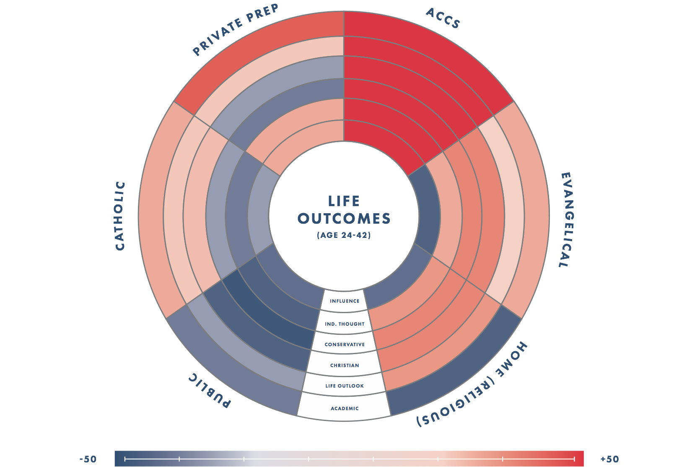

Slide 8
How much time did students spend at the school?
Average ACCS Alumni tenure at an ACCS school was
8 Years for this survey.
What is an ACCS School?
Member schools meet standards to be called “classical Christian.” Accredited ACCS members meet higher standards. 72% of Alumni contacted were from accredited schools.
Notes:
Now, a few slides about the report you’re about to see. ACCS alumni in this survey spent an average of eight years at the school from which they graduated. This fact helps to ensure that the effects seen herein are the result of a single-school’s impact. Most of the ACCS schools in the survey were the association’s longest standing schools since they had the most graduates. These tended to be schools that were founded in the 1990’s and accredited by the ACCS—about 72% of total alumni names collected happened to be from ACCS accredited schools.

Slide 9
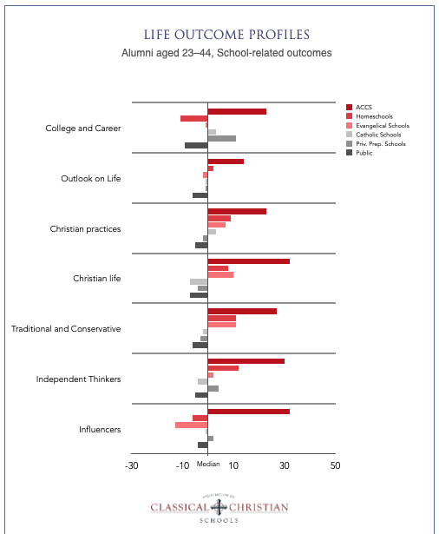

Slide 10

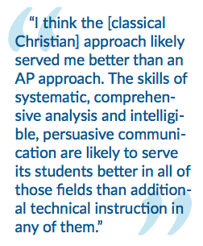
Prepared for college & University, prepared for job, Read books, Percent that earned a Bachelor’s degree or more, College GPA.
Andrew Brinkerhoff
CERN Physicist
Index: Prepared for College and Career
Scale: Percentage of respondents above or below the median (~50%). Ie. “40” means 90% of respondents.
Blue = Actual responses on the survey
Red = Household influence statistically adjusted to reflect the school’s impact alone
Notes:
First profile: “College and Career.” While ACCS schools are tasked with a different mission, a side benefit of the classical method is academic preparedness. This difference is the most substantiated because, in addition to this research, we have corroborating research on ACCS student SAT testing and college readiness.
For each of these indexes, we’ve selected an ACCS alumnus as a representative. You can visit classicaldifference.org to read their full stories.
Andrew Brinkerhoff, who graduated from an ACCS school in Ohio, is a CERN physicist who helped discover the Higgs Boson particle—a major accomplishment in theoretical physics. Read his story here: https://www.classicaldifference.com/alumni-profile-andrew-brinkerhoff/
In this chart both the red and blue lines show a significant difference. The red lines reflect the school’s effect, isolated from other family factors. This calibration is accomplished through the previously mentioned Regression Analysis technique which can identify and remove factors like family income, frequency of family church attendance, parents’ marital status, and so on.
The zero point is the median, or about 50%. Lines to the right or left are above or below the median, or average score. In actual data (blue), the ACCS reports a score of 32. This point system reflects the degree of influence that a school has on a scale from -50 to +50. These points can be turned into percentages by adding 50 to those over 50. Thus, 82% of ACCS respondents reported above the median (50% plus 32%). The raw data on public schools shows -10%, or when added to 50%, we can see that 40% of public alumni were prepared for college. Let’s see why.

Slide 11
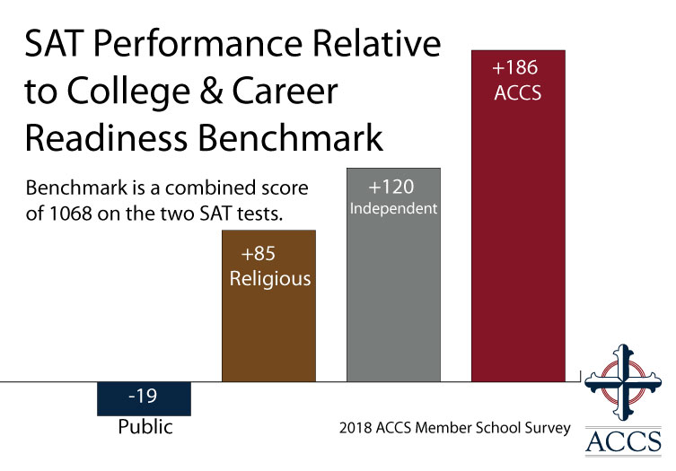
Alumni said they were well prepared
for college by their high school
Percent of Respondents who answered they
were prepared perfectly or very well for college
Notes:
ACCS alumni believe they were well prepared by their ACCS school. Notably, they believe this in greater numbers than preparatory schools. Among evangelical Christian schools, they were almost twice as likely to say this. The bars here are green which means these are the actual percentages of respondents who said they were perfectly or very well prepared for college.
The opinions of our Alumni are supported by the ongoing tracking research that the ACCS does in a survey of our high school student on college readiness every other year.
This graph is based on the average SAT scores of ACCS graduates.
Based on this we see ACCS alumni were well prepared for college. And, not surprisingly, further data shows that ACCS graduates do well in college.

Slide 12
ACCS Graduates Find Success in College
Earned A’s or Mostly A’s
in College
Earned a BA
or higher in college
ACCS
ACCS
Percent of respondents answering “A’s or Mostly A’s”
Notes:
Almost 55% of ACCS alumni earned A’s or mostly A’s in college, and when corrected to show only the school effect, shown in red, about 47% of ACCS alumni received mostly A’s—still the highest of any group.
The actual data shows that more ACCS students, than any other group, complete their bachelor’s degree, and many earn higher degrees. Nearly 90% of ACCS respondents surveyed completed college. Overall, homeschoolers were significantly less likely to have completed college. From these results, it appears that the more structured an educational experience is, when growing up, the more likely the completion of college.

Slide 13
ACCS Grads compare favorably against
other Christian schools
in job preparation
Percent who felt well prepared for job
Notes:
We also see that ACCS alumni are well prepared for their jobs—about the same as non-religious prep schools. They report being significantly more prepared than evangelical or homeschool families.

Slide 14
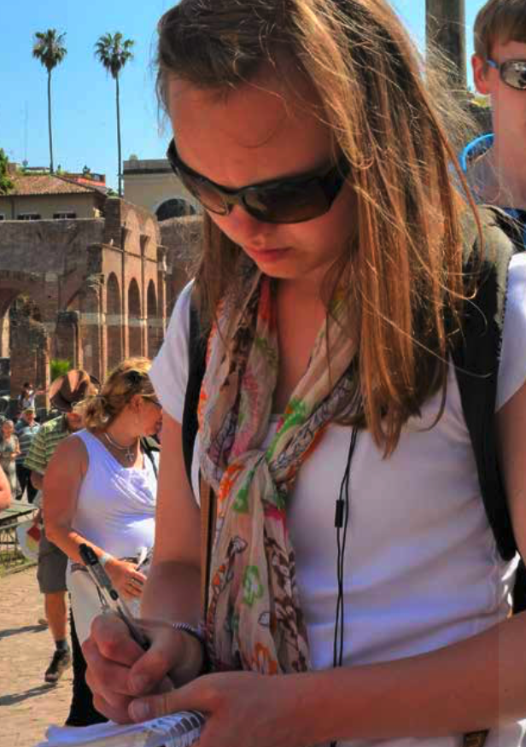
Percent of respondents above the median answer for: Thankfulness, God’s Calling to a particular line of work, Everything, even suffering, in God’s plan, Trust people,-Helplessness, -no Goals.
Nicole Ault
Journalist
Index: Life Outlook
“CCE [teaches that the] world is integrated and purposeful, and therefore abundantly fascinating. Everything in creation…belongs to God, and studying the world—from ancient literature to calculus—is a way of knowing Him better. There is nothing to fear and everything to learn.
Life is rich.”
Scale: Percentage points above or below the median (~50%). Ie. “40” means 90% of respondents.
Blue = Actual responses on the survey
Red = Household influence adjusted to reflect the school’s impact alone
Notes:
When it comes down to it, this is perhaps the most important index for parents—“Life Outlook.” It’s also one of the most distinctive for ACCS alumni. It seems that “happiness” is the illusive measure that so many pursue and so few find. And, based on nationwide statistics, it’s getting harder. Among the ages studied in this survey, 25-44-year old’s, the second highest cause of death, behind accident, is suicide (2017 National Vital Statistics Report, Volume 68, Num 6, Melonie Heron, U.S. Department of Health and Human Services.)
Attempts are made to fill the nationwide happiness void, but perhaps it is more a factor of a person’s outlook on life, than what they own or experiences they have.
Nicole Ault, ACCS alumnus and journalist, explains the outlook on life that her ACCS school gave to her: https://www.classicaldifference.com/alumni-profile-reclaiming-the-media-for-christ/
This index is made up of attitudes, beliefs, and practices that are indicators of a healthy life perspective. Of course, this doesn’t equate to happiness in every case, but we believe it is a good indicator. Do you feel a sense of purpose? Are you called by God to do something important? Is your suffering part of His plan? Has God equipped you for this mission? Are you grateful for all that you have? If your answers are yes to these questions, you will likely be more trusting, more optimistic, and feel like life is worthwhile. If you were taught to see the world in this way—if your paideia, or life outlook were formed to love these things—then happiness is likely to come more naturally. This is why our purpose statement at the beginning of this presentation is so important to keep in mind. We are cultivating students to love the right things, rightly, so they will accept their calling.
When corrected for family factors, only the ACCS schools and Homeschools are above the median.
Now let’s review a few of the indicators we put into this index.

Slide 15
My spirituality gives me a feeling of fulfillment
Notes:
Overall, 80% of ACCS alumni mostly or completely agree that their spirituality is important to them. Note that around 40% of alumni from the first three groups (public, non-religious, and Catholic) say this—about 10 points below the median. Clearly, education greatly impacts one’s outlook on life, especially if you look at the red bars, corrected for other and family factors. All of the non-Catholic Christian schools fair better than the first three, but ACCS alumni are still nearly 10 points higher, giving our graduates a significant higher measure over the public, non-religious and Catholic sectors.
This question was asked in a 6-question set about the person’s relationship with God. We can see more by looking at the follow-up questions.

Slide 16
I try to strengthen my relationship with God
Those who agreed or strongly agreed with this statement
Notes:
In this follow up question, there is no significant difference (within the margin of error) between the Evangelical, Home, and ACCS students as they try to strengthen their relationship with God. Once again, Christian education, of some type, clearly matters, even for children raised in Christian homes, as family factors have been statistically neutralized here.
In the area of life outlook, however, there were a few important differences.

Slide 17
Everything that happens, including my suffering,
is a part of God’s plan
Those who agreed or strongly agreed with this statement
Notes:
There was a significant difference in the overall scores of ACCS alumni who believe that everything, including suffering, is part of God’s plan. It seems clear that when one’s life outlook takes this view of suffering; one is able to meet life’s challenges with a healthy and hopeful mindset and perspective.
Other questions within the survey cast further light on the outlook’s students took with them into adulthood based upon their schools.

Slide 18
Life often lacks clear goals, or a sense of direction
Percent who agree with this statement
Notes:
ACCS alumni have a clear sense of purpose and direction. Only 14% of ACCS alumni said that life lacks clear goals or a sense of direction. ACCS schools give students perspective on life through a study of theology, philosophy, history, and literature—with a wide-ranging exposure to the Western Canon. And we teach them to love the Lord with their minds, souls, and strength throughout every subject. We believe this perspective shows up when alumni think about their significance in the grand scheme of things.
This question indicates ACCS alumni are hopeful. Evidence of this outlook shows up in the data in other ways…

Slide 19
Feel helpless dealing with life’s problems
Notes:
The outlook of ACCS alumni is reflected in many different ways throughout the survey. A sense of accomplishment and ‘grit’ has been shown by researchers like Angela Duckworth to contribute to success. We see in the chart that ACCS alumni are much less likely than others to feel helpless, which contributes to a positive outlook.
This mindset shows up in ways that go deeper…

Slide 20
ACCS Graduates Trust People Around Them
(result of a positive outlook)
Percent who responded very important or extremely important.
Notes:
This graph shows the responses of school graduates to “who do you trust” questions. Note here, the gold bar is ACCS, the light blue are Evangelical “Christian” schools, the dark is secular. Catholic schools tend to trend with secular but are in gray here. Blue-shading is because these are actual (raw as in not corrected for family and other factors) numbers. The school impact figures, usually in red, are not significantly different.
The first takeaway from this, and the next slide, is how much more ACCS alumni trust others. Given the answers elsewhere in the survey, we believe this relates to something besides having a rational basis for this trust. Psychologists have long held that trust is a strong indicator of a positive life outlook. An article in the March 20, 2014. issue of The Atlantic associates “generalized trust” with better health and happiness, and with intelligence. ACCS grads are the most trusting of personal relationships in every category.
Catholic school alumni seem to be the least likely to trust people in their church, which might be influenced by recent scandals. This is a warning for all of us when it comes to integrity in the church. As regarding strangers and co-workers, ACCS alumni are unique, in that they are highly trusting, although this is so across the board for them in general, more than any other alumni.
ACCS graduates are significantly more likely to trust those they encounter on a daily basis. As the categories above show. This trust carries over into how they engage the broader world outside of their personal circles…

Slide 21
ACCS Graduates Trust Institutions and Outsiders
(Indicative that they are stable and not threatened by outsiders)
Percent who responded very important or extremely important.
Notes:
This graph represents trust in more casual or institutional contacts, rather than friends and neighbors. Note that ACCS alumni are not the top group in any of these categories— secular preparatory schools are. But these groups are also typically hostile to Evangelical Christians, so we would expect to see lower trust factors for ACCS alumni.
However, ACCS alumni tend trust these groups more than their counterparts at other Evangelical Christian schools. We believe this continues to support the thesis that a greater life outlook is reflected in trust.
ACCS alumni are also much more likely to trust scientists and atheists than other Evangelicals. In contrast to this, we’ll see later that they are not as willing as the other groups to believe scientism, or atheistic evolution. This plays into the “Intellectual Independence” index which will come later. It strongly appears that ACCS alumni do not feel as threatened by the anti-Christian ideas that come their way. Most ACCS schools are not afraid to expose students to scientific or atheistic ideas, and they teach students to rightly understand them. This seems to carry forward into their lives.
Among conservative Christian evangelically educated groups, ACCS alumni are more likely to trust the federal government and the mass media, though they are generally less likely to trust them than the secular groups. Once again, we’ll see later that the bias these groups inject into the conversation does not influence ACCS graduates nearly as much as the other groups. In other words, we’ll see later that ACCS alumni stand out as strongly traditional and conservative on matters espoused by government, and media. Yet, they trust more in general. Possibly, this is because ACCS schools take to heart Aristotle’s maxim that an educated man can “entertain a thought without accepting it.”
From “trust” we can look at just a few of the other positive outlook markers…

Slide 22
I have so much in life to be thankful for
Level of agreement with this statement (raw)
Notes:
ACCS schools influence students to have gratitude at a higher rate than any other type of school, by a significant margin.
We’ve included the raw scale to show, with seven as the highest possible choice, that ACCS averages are very near the top of the bracket. While many respondents had general basic agreement with this statement, ACCS alumni were clear outliers in the magnitude of their thankfulness.

Slide 23
I have so much in life to be thankful for
Those who agreed or strongly agreed with this statement
Notes:
The same question here, corrected for the school influence only, is similar, or even more pronounced, than the previous graph. ACCS alumni are significantly more grateful.
Finally, the outlook factor that is particularly encouraging: friendship…

Slide 24
Number of close friends
Percent of respondents who reported more close friends than the median, adjusted to isolate the school’s influence.
Notes:
Respondents were asked to think about their close friends from their neighborhood, family, church, or wherever, and asked how many they had. The median answer for the whole population was 3 friends. However, 90% of ACCS alumni reported more friends than this. When asked to name their “close ties”, the percentage was 94% above the median. The data consistently represents that ACCS alumni have more and closer relationships into adulthood, and ACCS alumni count among these close ties, people they went to high school with.
83% of ACCS alumni talk with these friends about religion and significantly more of them interact frequently with these friends on a weekly basis.
A healthy view of suffering, life goals, gratitude, trust of others, and strong friendships are significant indicators that our students enjoy life with a depth and understanding that is unmatched, and that much, if not most, of the cause for this is the ACCS school they attended.

Slide 25
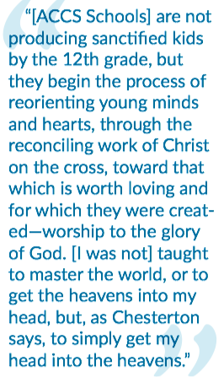
Percent of respondents above the median answer for: Attend church regularly, Small group study, regularly read bible, volunteer at church, give to church, Obligation to special religious practices
Will Frazier
Finance
Index: Christian Commitment
Scale: Percentage points above or below the median (~50%). Ie. “40” means 90% of respondents.
Blue = Actual responses on the survey
Red = Household influence adjusted to reflect the school’s impact alone
Notes:
After preparation for college and life outlook have been considered, we can now look at two indexes that reflect aspects of ACCS alumni’s Christian life. The first is “Christian Commitment”, the second, “Christian Lifestyle.”
Will Frazier, ACCS Alumnus and financial analyst, puts the school’s role in perspective: https://www.classicaldifference.com/alumni-profile-will-frazier/
The first index is “Christian Commitment” which reflects a person’s practices. Things like church attendance, Bible studies, and volunteering combined with desire and obligation to observe religious practices were used for this index.
For this index, there are two groups that place above the median along with the ACCS—Homeschool and Evangelical schools. While they do show strength here as well, the ACCS shows the most pronounced influence in this area by a wide margin.
Let’s look at the details of this difference…

Slide 26
Have doubts about religious beliefs
Notes:
When the data is corrected to reflect only the school effect, the “doubts about their faith” reported by ACCS alumni are not significantly different from their peers who graduated from evangelical or home schools.
ACCS alumni’s commitment to their faith, however, shows some significant differences…

Slide 27
Committed to the Church
Frequency of
religious service attendance
Obligation to regularly
practice spiritual disciplines
ACCS
Percent that attend more than 3 times per month
(Range 1-7 with 7 as “Strongly Agree” )
Notes:
In these questions, we see the most obvious indicators of alumni Christian practice and attitude—frequency of church attendance is the percent who attended church more than 3 times per month. The red bar for the ACCS shows a significantly higher church attendance than other groups. The blue bar shows the actual response data, which is more than 20 percentage points higher than the next highest group’s actual data—Evangelical schools. This shows a significant effect from ACCS schools on their alumni practices.
We can see the attitudes of alumni regarding spiritual disciplines, again corrected to reflect only the school effect. ACCS alumni have a clear and significantly different viewpoint than other graduates.
These two factors seem to answer the question most of us want to know: Do ACCS schools influence whether a student will remain faithful to church and remain committed to spiritual discipline?
With nearly 90% of ACCS alumni attending church at least 3 times a month, we asked how else are they involved?

Slide 28
Active in their churches
Attend religious small group
Leaders in Their Congregation
ACCS
ACCS
Notes:
Digging a bit deeper, the data shows that ACCS alumni are more actively involved in their churches. When you look at the actual (raw) data, the difference is even more pronounced. 83% of ACCS alumni report attending a small group at least once per week. And they lead in their congregations in greater numbers. But when corrected for other factors, the differences on the right graph are not significant. So, this “leadership” aspect could be more related to other components than the school. Nonetheless, ACCS alumni take their experiences and education into leadership roles at greater numbers than those from other school groups.
At a personal level, ACCS alumni show different evidences of commitment to the faith…

Slide 29
How much do alumni read their bibles (alone)?
ACCS
Left/red: Percent who exceed “monthly”.
Right scale (image): 6= weekly 4= Monthly 1= once or twice a year
Notes:
When corrected for the school influence alone, about 70% of ACCS alumni read their Bibles more than the median.
The scale on the right side shows the frequency of bible reading 1=never, 2 once or twice a year, 3 several times a year, 4 about once a month, 5 a few times a month, 6 once a week, 7 a few times a week, and 8 once a day or more. ACCS alumni average a 6 on this 8-point scale.
ACCS alumni also read more religious literature.

Slide 30
Read religious literature (not Bible)
Notes:
Beyond the Bible, ACCS alumni are also more likely to read religious literature.
To round out this index, we looked at how students were prioritizing in their lives, for example, what kind of employment they were seeking…

Slide 31
What type of jobs are
ACCS alumni seeking?
Percent who responded very important or extremely important.
Notes:
Vocational priority indicates where alumni spend a big segment their time. And for ACCS alumni, their priorities when choosing a career are different from the other school groups.
Note here, the gold bar is ACCS as usual, the gold-red are Evangelical Christian schools, the dark red bar is secular. The Catholic schools tend to trend with secular but are in bright red here.
ACCS alumni strongly seek a job that fulfills their religious calling, they want to help others—significantly more than their Evangelical counterparts, and they are willing to take less pay and sacrifice family proximity to follow this calling.
Note: An interest in creativity is unique to both preparatory and ACCS schools.
The takeaway is that ACCS alumni are likely to serve more through their vocation, particularly in a religious calling, and they are willing to sacrifice financially to do it.
How do these practices bear out in life? This we will see in the “Christian Life index”, up next.

Slide 32
Percent of respondents above the median answer for: Accept church authority, Family eat, pray, talk about god, read bible together, - never lived together before married, Never divorced.
Megan Best
Teacher
Index: Christian Life
Classical Christian education never wants to leave the heart or mind wanting. Social media apps, how-to books, and other ingenious inventions will come and go. They always change based on human desires or vices. Classical Christian education, though, links itself with the best parts of human culture, and unites students with long-lasting, forever relevant ideas.
Scale: Percentage points above or below the median (~50%). Ie. “40” means 90% of respondents.
Blue = Actual responses on the survey
Red = Household influence adjusted to reflect the school’s impact alone
Notes:
The “Christian Life” index attempts to capture lifestyle differences for alumni that are derived from their beliefs and are a reflection of their Christian commitment.
Megan Best went to an ACCS school and now teaches at that school. She sums up her life choice to serve in an ACCS school: https://www.classicaldifference.com/is-classical-christian-education-worthwhile/
As with “Christian Commitment”, the “Christian Life” index shows some common ground with Evangelical and Homeschools, though on very different scales. Clearly, students are better off in a conservative Christian school environment overall, if your desire is to foster a Christian life. Given the biblical call in Ephesians for fathers to raise their children in the Paideia of the Lord, this shouldn’t need to be proven by research. Paideia, the ancient Greek word translates to at least 7 words like fear, instruction, education, training, and admonition. The translation is wide because the concept is big. ACCS schools base their entire educational model on this concept and its underlying principles. Conventional schools typically do not. This creates a very unique environment in ACCS schools where Christian Paideia is infused throughout the method, content, and ethos of the schools. We believe this is reflected in the differences we see between conventional Christian schools and Evangelical or Homeschools.
Here, the ACCS school effect is more than three times as pronounced when compared to the next highest form of school. The underlying data helps us understand these differences in more detail…

Slide 33
How alumni act within the church
Accept Authority
Of Church and Church Leadership
Obligation to Tithe 10%
Notes:
Within the church ACCS alumni have very different attitudes when compared to any of the other sectors of school alumni. Nearly 70% accept church authority, and 70% believe they have an obligation to tithe. Again, these are adjusted to show only the effect of the school.

Slide 34
Amount given to church
Notes:
While ACCS alumni reported an obligation to give 10%, they actually gave about the same as other Evangelical groups.

Slide 35
Christianity is important in the home
Family Eats Together
Family talks about God
Placeholder
Number of days each week, on average…
Notes:
When it comes to the home, ACCS alumni eat together more and talk about God more. The blue bar indicates the actual data for this question, to show that the actual number reflects high above the median.

Slide 36
Invest time in their communities
Total volunteer
hours logged
Percent that volunteer for organization
that helps poor/elderly
Notes:
ACCS alumni invest in their communities. ACCS alumni volunteer at a greater rate, with the actual data showing a very high rate of volunteering—the median is about one hour per month. 70% of ACCS alumni report exceeding this number.
While most sectors reported about the same type of volunteering, ACCS alumni reported less emphasis on volunteering for youth programs, and more emphasis on helping the poor or elderly.
So far we have seen how ACCS alumni practice in the church, in the home, and in the community, now let’s look at the attitudes and beliefs they have…

Slide 37
Marital Satisfaction
“Satisfied” or “Very satisfied”
Notes:
First, let’s look at the satisfaction various groups have within marriage. When we look at marital satisfaction, there is a slight advantage for ACCS alumni in the raw data. However, when corrected for the school’s affect only, there is almost no significant difference across any of the groups. All sit near the median. Marital satisfaction seems independent of the school attended.
Interestingly, ACCS alumni, however, have very different views of marriage…

Slide 38
Beliefs About Marriage
Living together is morally wrong
Divorce is morally wrong
Notes:
There are differences in beliefs between ACCS alumni and the other school groups. ACCS alumni believe living together outside of marriage is morally wrong. The blue bar shows the actual data, which is much more pronounced than the adjusted data. This means that, while the school’s impact is about the same for all 3 Evangelical groups, the raw data shows that ACCS alumni are much more likely to see living together as wrong. Public, preparatory, and Catholic schools are significantly less likely to influence students to believe this.
ACCS alumni are more likely to say that divorce is morally wrong “most or all of the time.” Again, the raw data shows even stronger convictions from ACCS alumni.
With marital satisfaction about the same, and beliefs about marriage’s proper moral context different, how does this play out in real life…?

Slide 39
Healthy Families
Divorced or separated
Unmarried, living together
Notes:
The divorce rate among ACCS alumni is strikingly small. For these slides, we used actual data rather than corrected for school effect because the reported numbers for ACCS graduates were at or near zero, so the correction created a misleading result—though the graphs took the same shape, showing the school effect was real and significant. Also, for statistical reasons, these are presented as probabilities rather than the usual percentage. Thus, we used the green color indicating an actual scale. For example, based on the data, a random alumnus selected from the public school would have about a 6% chance of being divorced. ACCS alumni would have less than a 1% chance.
No ACCS graduates reported living together currently. Very, very few reported every having lived together, which stands in contrast to other school types.
Any differences in the overall population’s age has been normalized. These reflect same-life stage alumni.
ACCS schools influence on the beliefs, and more significantly the behavior of our alumni.

Slide 40
Has a child in a religious school
Notes:
Besides marriage fidelity, a higher percentage of ACCS alumni report putting their children in a Christian school than the other school groups. Since the ACCS did not control the survey, we have no way of knowing if the school is classical.
All told, with practices in church, home, life, and marriage showing distinct differences, the “Christian Life” index reflects a distinct lifestyle among ACCS alumni.

Slide 41
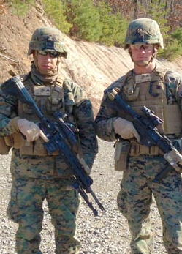
Percent of respondents above the median answer for: Can Govt. solve problems, good sexual ethics, who God is, authority of church, science and faith compatible, no errors in bible, more likely to know LGBT, less likely to accept LGBT lifestyle.
Michael Fitts
U.S. Marine
Index: Conservative and Traditional
The longer my boots were on the ground, the more I learned that the answers to complex dilemmas are not always so simplistic. The depth of thought provided by my education helped keep me grounded during times of stress.
Scale: Percentage points above or below the median (~50%). Ie. “40” means 90% of respondents.
Blue = Actual responses on the survey
Red = Household influence adjusted to reflect the school’s impact alone
Notes:
The “Conservative and Traditional” index attempts to measure the political, social, and orthodox views of alumni. All three forms of Evangelical schools show strength on this index. ACCS school differences are still more pronounced. Even when isolated to the “school only” cause, ACCS schools report more than twice the index score.
Michael Fitts, U.S. Marine instructor, saw the distinction that his ACCS education gave him… https://www.classicaldifference.com/alumni-profile-michael-fitts/.
This index consolidates attitudes and beliefs, along with a few behavioral factors relating to how traditional or conservative alumni are in the area of sexual ethics, government’s role in solving problems, faith vs. science, and theological questions of authority, the Bible, and sin. For example, how do ACCS alumni view the problems in America today…

Slide 42
One of the main problems in the U.S.
is lack of authority.
Mostly or completely agree— % above median
Notes:
First, the response from ACCS alumni on this question is puzzling. ACCS alumni do not think lack of respect for authority is a problem in the U.S. At least not relative to graduates of other evangelical schools. ACCS alumni compare most closely with private preparatory schools on this question.
This question was grouped with questions like, “The dominant culture in the U.S. is hostile to my moral and spiritual values.”— to which ACCS answered in the affirmative, similarly to Evangelical and Homeschool, and different than the public, nonreligious, and Catholic who also thought authority was less of a problem. So, the reason for the lower ACCS agreement may be that the ACCS alumni chose one of the other choices as “more serious” from the list.
25% of the ACCS group were above the median indicator “mostly or completely agreed” which means 75% either somewhat agreed, were neutral, or disagreed. Possibly, this could reflect a deeper understanding of “main problems”? Or, possibly, ACCS alumni were influenced to have less concern about respect for authority.
To understand this response, we looked at other data in the survey. Since other data show that ACCS respect authority in churches at higher levels, and of the Bible, there is probably an underlying story to this one.
When it comes to being morally conservative, their answers are less ambiguous.

Slide 43
The federal government should do more to solve social problems
Mostly agree or completely agree
Notes:
About 23% of ACCS alumni surveyed agree that the federal government should do more to solve social problems—77% do not agree.
About half of all students in public, prep, and Catholic schools agree with this statement, thus there is a sharp divide. Evangelical and Homeschool students are about the same as the ACCS on this factor. The “school effect” red chart looks about the same relative to one another.
At a time when socialism is nearing 30% approval with this age-group, it’s clear that all three types of conservative Christian education–Evangelical, Homeschool, and ACCS–make a difference in what students take with them into adulthood.

Slide 44
Social Policies
Premarital sex is morally wrong
Gay marriage is morally wrong
Always or almost always morally wrong
Always or almost always morally wrong
Notes:
The actual data shows that ACCS alumni are more socially conservative than their counterparts who graduated from Evangelical Christian schools. We saw their different marriage attitudes earlier. This particular set of questions report their opinions on a broader set of sexual ethics. And the differences are wide—below 30% for secular schools and nearing 90% for ACCS. When the formula is applied to isolate the cause to the school, the differences are slightly less pronounced, but still significant. We used actual numbers here to show just how many alumni hold to traditional views.

Slide 45
Orthodoxy
Bible infallible guide for
personal faith and behavior
There are errors in the Bible
regarding Science or History
ACCS
ACCS
Notes:
ACCS alumni have pronounced differences with all schools, particularly secular and Catholic, when it comes to orthodoxy. They believe the Bible is infallible.
ACCS graduates believe the Bible is true with respect to history and science. We believe this is because ACCS schools typically do not isolate these subjects from “Bible class”, so students grow to understand how the truth of the Bible is true for everything, not just personal spirituality.
This graph shows the percent that “agreed” in some form.
We’ve seen that ACCS alumni are about as politically conservative as their Evangelical Christian school counterparts, but are more orthodox in their Christianity, and more socially conservative than all groups.

Slide 46
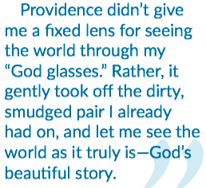
Percent of respondents above the median answer for: independent views, Reading, Science, willing to disagree, accept differences but willing to challenge (This measure uses multiple questions in conjunction to reveal practices and attitudes).
Marissa Black
Journalist
Index: Independent thinkers
[CCE]
Scale: Percentage points above or below the median (~50%). Ie. “40” means 90% of respondents.
Blue = Actual responses on the survey
Red = Household influence adjusted to reflect the school’s impact alone
Notes:
The last two indices reflect the independence of mind, and social influence of ACCS alumni. These are important when gauging the cultural influence of each group.
Marissa Black, ACCS Alumni and journalist sums up her takeaway: https://www.classicaldifference.com/alumni-profile-marissa-black/
ACCS alumni score more than 2x higher than homeschoolers and much higher than all other groups on this index. Classical education has long been known as a form of education that “teaches students how to think well.” This reputation is supported by this data.
The “Independent Thinkers” index is different than the other indices because on top of using several direct factors, the direct factors were also used with with several indirect factors that when combined, strongly indicate independence of mind. We’ll start with a few interesting results from the survey…

Slide 47
Obligation to care for the environment
Notes:
Given the conservative numbers we just saw, it seems surprising the ACCS alumni are the most likely to feel an obligation to care for the environment. This question was asked in a series of “obligation” questions about religious practices, business ethics, and personal practices. ACCS alumni generally answered in the affirmative more than any other group on most of the obligation questions. This could indicate a higher general level of felt responsibility among ACCS alumni. These data, when considered with other combinations, reveals the independence of ACCS alumni.

Slide 48
Relationships do not shape their moral compass
Gay Marriage is
Morally Wrong
Know LGBT Person
Notes:
Commonly, if you know someone, you tend not to be as critical of them. However, while ACCS alumni are more likely to know a person who identifies as LGBT than any other group, they are much more likely to believe gay marriage is wrong. You can see the alignment of knowing/supporting gay marriage in the other school segments. The less likely a group are to know a LGBTQ person, the more they are likely to believe their behavior wrong.
This is proof of independence of mind. Note that these differences are isolated to the school’s effect.

Slide 49
Trust Scientists
ACCS Alumni
are not swayed
by “consensus”
Science and religion are mostly compatible
ACCS Graduates are
most likely to…
Trust scientists
Believe science and religion
are compatible
There are errors in
the Bible regarding Science or History
Believe the bible is true, both in science and history
Notes:
ACCS alumni trust scientists at about the same level as their secular educated counterparts, and much more than their Evangelical counterparts. They believe science and religion are mostly compatible—by a wide margin—unlike their Evangelical counterparts. But, even more so than their Evangelical counterparts, they do not believe that the Bible has errors regarding science or history. Why this apparent contradiction?
ACCS alumni are able to take the good from science without being swayed by their arguments about scripture. Classical Christian education integrates Christ into every area of study. He’s not relegated to Bible class or a prayer before class starts. Other data in this survey shows that ACCS alumni also took more advanced science in high school.
From this triad, it is apparent that ACCS alumni are adept at thinking independently rather than dogmatically about science and religion.

Slide 50
Agree: God created the world in 6- 24 hour days
Notes:
ACCS alumni were the least likely of Evangelicals to believe in young-earth creation. As we just saw, ACCS alumni strongly believe that the Bible is without error regarding science. So, the integration of old-earth creation may be a result of their attempt to reconcile these two things in their minds.
This may concern some, and seen as a compromise. We believe that the complex literature to which ACCS alumni are exposed allows them to believe the Bible to be accurate while understanding it in a less concrete way.

Slide 51
More tolerant,
but more challenging
Be more tolerant of non-Christian groups
X
Religion is a private matter.
Challenge religious views in public
Society should be more tolerant
of non-Christian religions
Okay to Say Things In Public Offensive to Religious Groups
“Religion is a private matter; should be
kept out of social and political”
Notes:
Here, we see an attitude difference. ACCS alumni are the most likely of evangelically educated students to be tolerant of Non-Christian religions—about the same as secular prep schools. While they are tolerant, they do not believe that religion is to remain private—they are far more committed, than the other groups, to the belief that religion should be in the public square. And, to reinforce this distinction, ACCS alumni are far more likely to assert that it’s okay to say things that might be deemed offensive to religious groups. In this day and age, this level of independence is essential for reasoned discourse in the public square, and ACCS alumni are unique in this way.
This combination shows that, again, ACCS alumni buck the natural categories. ACCS schools train students to engage their faith in every aspect of life—public and private—and they teach them to respectfully engage in substantive debates through our focus on rhetoric.

Slide 52
Independent AND well read
Total Reading
Read a non-religious
book
Notes:
Finally, under this topic, we can see that ACCS alumni read more, almost twice as much on average, than secular school graduates. Also, their reading includes non-religious books more frequently than those from Evangelical schools.
Classical education promises to teach students how to think, and in support of this, the evidence shows that ACCS alumni can think well, and think for themselves.

Slide 53
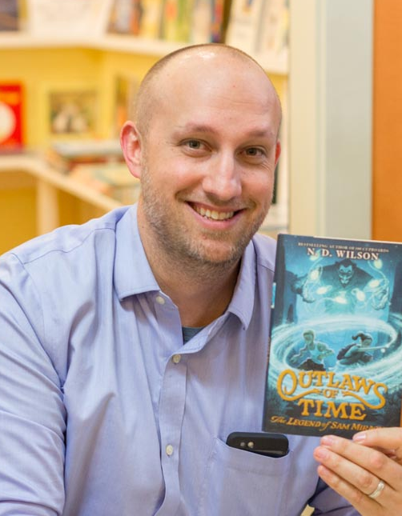
Percent of respondents above the median answer for: Know elected officials, CEO’s, Community leaders, Atheists, Read non-religious books, Volunteer and Lead non-church orgs, Obliged to take action, Believe they can impact, give to any organization, Ok to offend in public discourse, Job is calling by God, accept low job pay.
N.D. Wilson
Author/Filmmaker
Index: Influential
CCE gives students something valuable to squander. I think of every CCE grad as a trust-fund kid. What will they do with it? Do they comprehend what they’ve been given? Are they going to slack off and waste the educational wealth they’ve received? Or are they going to break a sweat and consciously serve God with it?
Notes:
One of the most significant index differences is in “Influence.” This metric looks at how likely ACCS alumni are able to engage in culture and society. And how likely they are to influence it. Of course, influence, like college preparation, is not an aim of classical Christian education. The data shows, however, that ACCS alumni stand alone as strong influencers in this index.
N.D. Wilson, ACCS alumni and best-selling author and film maker, challenges alumni in their service to the kingdom: https://www.classicaldifference.com/author-and-film-directory-n-d-wilson/
This measure is made up of several factors. One is the connection they have to influential people. Of course, the question was not asked this way. A series of questions were asked about knowing CEO’s, politicians, local community leaders, etc. Another measure was volunteering. While ACCS alumni reported more volunteerism in general, they were much more likely to volunteer and lead outside of their church.
ACCS alumni believe in public debate and that they have an obligation to address problems in our culture. They also seek jobs that will allow them to influence our communities and culture, and they are willing to take lower pay to do it.
Let’s look at ACCS alumni community involvement…

Slide 54
Number of organizations involved in
outside of your church
Notes:
ACCS alumni are involved and volunteer in organizations outside of their church and Christian community. We have already seen that ACCS alumni are active in their churches, this metric reveals that ACCS alumni are engaging with the community and charities outside of that as well. As they become involved in a wider community their influence spreads.

Slide 55
Percent who know an atheist
Notes:
Another point of interest is that ACCS graduates know, or are acquainted with, atheists at a higher percentage than the other groups. This indicates that ACCS alumni social circles extend beyond their own Christian communities and therefore they would have more reach and influence.

Slide 56
Willingness to protest
Notes:
In addition to getting involved and connecting with people who believe differently than they do, ACCS alumni are willing to put in the time to protest or actively support their causes. We saw previously that these causes are mostly conservative and strongly Christian. So, we can conclude that this aspect magnifies the impact of their influence on our culture in positive ways.

Slide 57
Likely to impact community
To what extent can you
impact community & politics
Know an influential person
Notes:
ACCS alumni feel empowered to impact their communities. More than twice the number of ACCS alumni believe they can have an impact versus other Evangelical school graduates, and they exceed preparatory and Catholic schools, the next highest, by a wide margin.
Pair this belief with ACCS alumni’s high likelihood of knowing an influential person and the combination is complimentary. Again, this reflects a combination of questions asking if they know a politician, a CEO, a community leader, etc. If you are interested in making a difference in our culture for good, ACCS Alumni are doing just that.

Slide 58
Time and Treasure
Giving (Financial)
Total logged
volunteer hours
Notes:
ACCS alumni are more likely to have influence through their time and their treasure. ACCS alumni donated time and treasure our of all all groups at a higher rate in the past 12 months. Again, the bars in red reflect the influence of the school, independent of other factors, like income.
Overall, ACCS alumni log more volunteer hours overall than the graduates from other schools.

Slide 59
Obligation to take action
against wrong/injustice
Notes:
Another indicator of influence is in ACCS alumni’s obligation to take action against wrong and injustice.
Overall, we can see why the influence of ACCS alumni is more pronounced than with any other group. This is due to integrated subjects and an ethics-based assessment of every aspect of creation. Which is unique at ACCS schools. Combined with strong independence of mind, Christian perspective, and conservative lifestyle, the alumni of ACCS schools are having a multiplying effect on turning our culture in the right direction.

Slide 60
With such a comprehensive study, some answers may need more explanation.
The next few slides reflect unexpected
responses by ACCS alumni that would require
further study to explain.
Notes:
In any survey of this size, there are a few results that seem strange, interesting, and are indicative of areas where ACCS schools need some work.

Slide 61
Percent who trust strangers
Notes:
Remember that ACCS alumni trust everyone more than their counterparts from other schools. But, for some reason, they trust strangers to a higher degree.

Slide 62
Sharing faith with strangers
Notes:
As trusting as ACCS alumni are of strangers, they are not particularly different in how they share their faith. Essentially, ACCS alumni did not stand out in the area of evangelism.

Slide 63
Close ties with family members
Notes:
ACCS alumni are not as close to family as the Catholic or Homeschool students are to their families. While similar to Evangelical schools, it seems that ACCS alumni, based on other answers in the survey, should/would be closer to family. This could be an area for future study or improvement.

Slide 64
Myth Busters:
75% of ACCS alumni were above the median in taking more math and science in high school than their peers. The next highest was prep schools at 56%
47% of ACCS alumni said the rules were too strict in high school—the LOWEST of any group except public school at 44%
Only 18% reported taking Business or Economic classes.
Notes:
A few myths came through from this survey.
Firstly, ACCS experience shows that a large number of graduates go into engineering. ACCS alumni report taking more science classes in high school than their counterparts from other schools. This is partially due to the fact that many ACCS schools require these subjects. But it’s still mythical belief that ACCS student are strong in literature and weak in science.
For those who think ACCS alumni will remember the uniforms and orderly environments of our schools as “oppressive”, the opposite is true.
And, not too surprisingly, few ACCS schools do much with business or economics.

Slide 65
ACCS Alumni blend academics, independence, and influence with Christian lifestyles and beliefs.
ACCS | Next Highest | Conclusions
23 | 11 Priv. Prep | Stronger academically and in career than any other group.
14 | 2 Homeschools | An outlook on life more likely to result in productivity and satisfaction
23/32 | 9/10 Homeschools/ Evang. Christ. | Christian in both practice and lifestyle.
27 | 11 Home&evang. | Conservative and traditional both in religion and socially.
30/32 | 12/2 Homeschool Priv. Prep | Independent thinkers with influence.
NA | NA | Several data-points indicate less of a “Family priority”
Notes:
ACCS alumni are strong players in two worlds: Their participation in their Christian community, and their influence on secular culture.
They are also the strongest group academically. They tie with private preparatory schools in career preparation. The most pronounced differences, among many highly distinct attributes, is the independence of mind and the influence they have in society. Which is higher than all the other school groups. They have a healthy life outlook, which is a key component of happiness.
In their Christian lives, they have strong commitment to their faith, and they hold to more traditionalist views with one notable exception—their acceptance of old-earth creation is higher than other Evangelical groups.
There were a few concerning and interesting details. The one concerning factor is that ACCS alumni report as less “family oriented” in that they prioritize jobs far from home (albeit many for missional purposes), and they report slightly lower marriage rates. however, when they do marry, they stay married, have children, and put those children in Christian schools.
Once again, the outcomes shown above are corrected for other life factors. So, the school is the most highly contributive factor for these scores. There are areas in which to focus on improvement, but overall ACCS students are significantly distinct in the ways that parents desire, and the Christian community needs. Probably the most important takeaway from this study is the magnitude of the difference between ACCS graduates and graduates from other schools. The other five categories’ results were almost always grouped together. There was very little significant difference. There were some distinctions between the Evangelical forms of education and the secular/Catholic forms. But none of these distinctions were as pronounced as the ACCS alumni responses. We believe this reflects the fact that all four forms of school, besides Homeschool and ACCS, are highly influenced by progressive ideology, purposes, methods, and content. Therefore, with the exception of Homeschools, which are too diverse to categorize, the results of Evangelical, Catholic, secular, or public, schools are closely matched. ACCS schools are the outliers with the greatest distinction.

Slide 66
An ACCS Alumni Study
“But the seed on good soil stands for those with
a noble and good heart, who hear the word, retain it,
and by persevering [100 fold more than was sown]”
— Luke 8
Notes:
The goal of the ACCS is and will remain to cultivate the soil of our children’s hearts so it is prepared to return 100-fold when the word of God is planted there. We have a long way to go before we have restored classical Christian education as it was practiced so effectively in the past. Twenty plus years into this movement, there is much work to be done in recovering the lost tools of education. Given classical Christian education’s long history of cultivating the hearts and minds of students, we should not need data to confirm that it meets this goal. But this study certainly reinforced what thousands of parents and classical educators already knew. Visit the classicaldifference.org to learn more. Or, to find a school, visit classicalchristian.org and click on “schools.”

Slide 67

Reported Good relationship with Teachers, administrators , and other students, A close-knit high school, Teachers Cared, enjoyed high school and were proud to have graduated from their HS.
Emily
Dewind
Index: Experience in High School
When I tell people I went to a classical Christian school they often ask, “What is that?” or “How is that different from regular school?” These questions always resonate with me because, if there is not a difference, then what is the point? … That was the true beauty of my classical Christian education. It prepared me not just to go on to college, it prepared me to go on to the world.
Notes:
Now for a bonus: The first 7 indexes reflect the outcomes, attitudes, beliefs and practices of alumni. With the distinct differences we’ve seen from the alumni of ACCS schools, it stands to reason that their classical school experience is quite different as well. This difference takes many forms, some of which lead parents and students to question whether it is worth it.
This final metric is included as an extra for parents. Often, students in the midst of a difficult time in school will seek other alternatives. They may not see the relevance of reading so many books from old authors. They may not like to write or speak so much. Or they may seek a STEM-based future career. Or parents may think the rigor will make their children “hate school.” Parents should realize that, with the perspective of time, these concerns fade.
Emily Dewind, a missionary, looks back on her experience: https://www.classicaldifference.com/bridging-the-gap/
ACCS grads appreciate their schools more, when looking back upon them from adulthood, than any other type of school graduate.

Slide 68
Believe they received a
high quality education in high school
Notes:
ACCS alumni believe they received a high-quality education. In these charts, we are using the majority of actual (raw) data since the corrective factor for “school alone” is embedded in the questions themselves.

Slide 69
ACCS students got along with each other
Notes:
Students at ACCS schools get along with one another.

Slide 70
Agreed “Teachers Cared”
Notes:
ACCS alumni feel their teachers cared about them.

Slide 71
“Enjoyed my high school”
Notes:
ACCS alumni enjoyed their high school.
Respondents, in nearly every data point in the survey, respected their school experience.
Now, one last slide to explain the way most of the data in this survey was reported.
(mostly agreed)

Slide 72
For the Curious
“Percent above median” was used because the question’s varied in format (1-7, 1-4, etc.) so a cut point was needed to get to a percent of respondents. Thus, a “median” was selected for some questions close to the actual median (if 3.7 was the median, 4.0 was chosen to allow for a percent above and below.). This was used when the question was a sliding scale of approval, etc. Sometimes, this cut point was defined by logic— those who agreed vs. those who disagreed. This took all questions throughout the survey to the same basic percentage— those who responded above this median cut point. This means that if the answer was below 50%, the respondents were actually responding negatively to the question. In other words, 40% agreed meant that 60% were neutral or disagreed.

